Slide 1
We Cannot Walk Alone
Summer 2022 Project

Slide 2
Our School Vision
At St Mary’s, we pride ourselves on the continuous progress, attainment and achievements of our pupils across all the curriculum subjects. For our pupils to be confident, independent learners with enquiring minds and a life-long love of learning, we offer outstanding teaching and learning provision alongside broad, experiential and memorable activities.
Our Young Transformers programme offers just that. The programme is intrinsically linked to our biblical vision:
Christian Vision:
I am the vine and you are the branches. If you remain with me and I with you then you will bear much fruit. Love one another as I have loved you. John 15.

Slide 3
We Cannot Walk Alone
This term, our children will be starting a major project around the theme of refugees and displacement around the world. Our aim is for children to understand more about the reasons why some people are forced to leave their homes in the hope to find safety elsewhere. We believe that as a Christian school with a Christian vision, we need to show consideration to vulnerable communities and create change for those with the highest need. Our aim is to educate children so they can make informed choices about displacement events that are impacting us now and in the future.

Slide 4
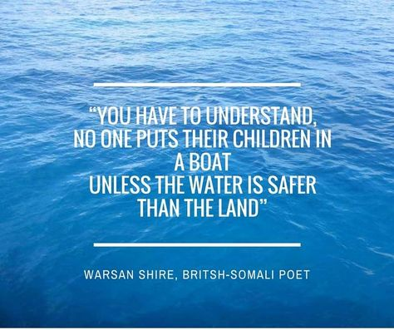
Why?
Notes:
https://www.unhcr.org/refugee-statistics/

Slide 5
What does the Bible say about refugees?
Matthew 25: 31-40.
“I was hungry and you gave me food, I was thirsty and you gave me drink, I was a stranger and you welcomed me.”
Exodus 12:49
“The same law applies both to the native-born and to the foreigner residing among you.”
Hebrews 13:2
“Do not forget to show hospitality to strangers, for by doing so some people have shown hospitality to angels without knowing it.”
Leviticus 24:22
“You are to have the same law for the foreigner and the native-born. I am the LORD your God.”
Ephesians 4:32
"Be kind and compassionate to one another, forgiving each other, just as in Christ God forgave you."
Zechariah 7:9-10
‘Administer true justice; show mercy and compassion to one another. Do not oppress the widow or the fatherless, the foreigner or the poor. Do not plot evil against each other.’
Notes:
https://www.unhcr.org/refugee-statistics/

Slide 6
What are our aims?
To educate children with the knowledge and skills around displacement so they are informed enough to form opinions.
To broaden this knowledge by offering them experiences such as first person accounts.
To provide opportunities for pupils to take action.
To celebrate what they have learnt.

Slide 7
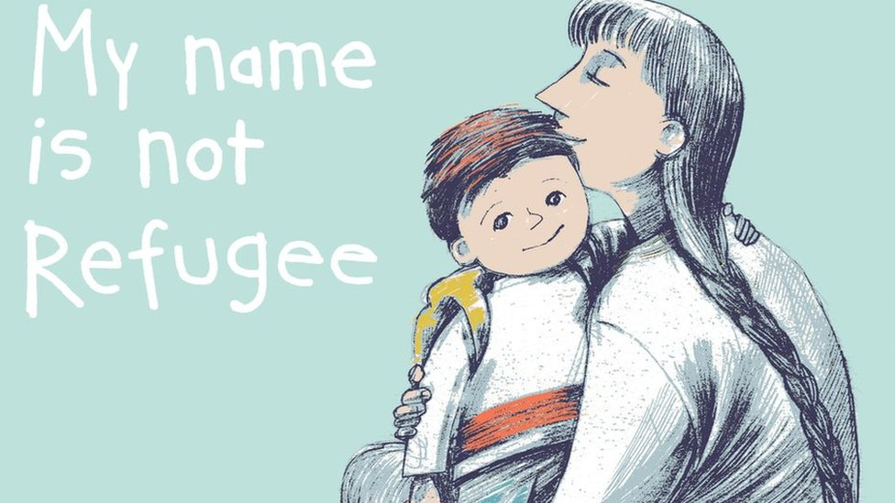
KS1 Literacy lessons
Children will be participating in a range of lessons where we will be focusing on key books that surround these topics. Our reading and writing lessons will focus on books that will engage children about the topic.
Year 1 My name is not refugee – Kate Milner and Refuge – Anne Booth and Sam Usher
Year 2 The Journey – Francesca Sanna and Wisp – Zana Fraillon and Grahame Baker Smith

Slide 8
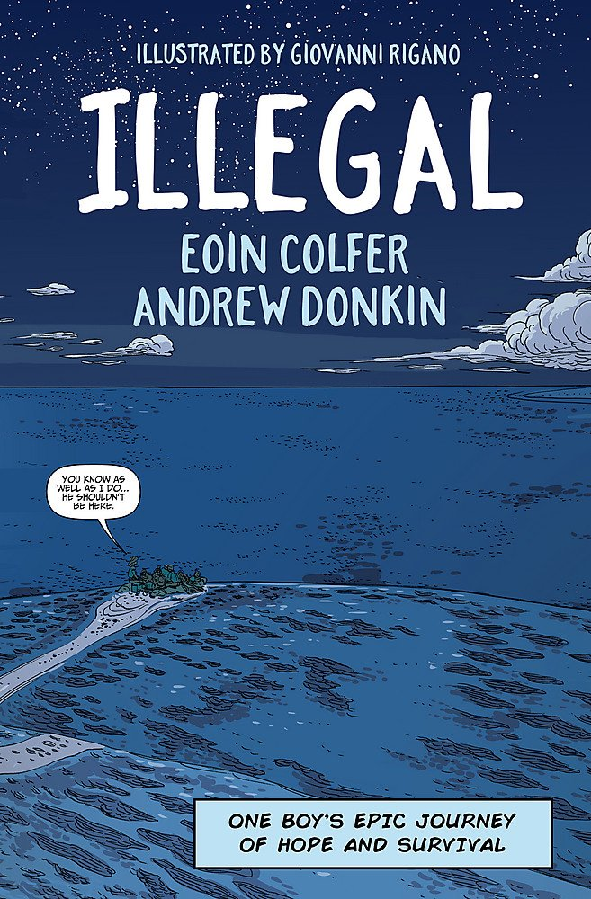
KS2 Literacy lessons
Year 6 Refugee boy – Benjamin Zephaniah and Illegal – Eoin Colfer and Andrew Donkin
Year 3 Azzi in between – Sarah Garland
Year 5 The boy at the back of the class – Onjali Q. Rauf
Year 4 On the move – Michael Rosen

Slide 9
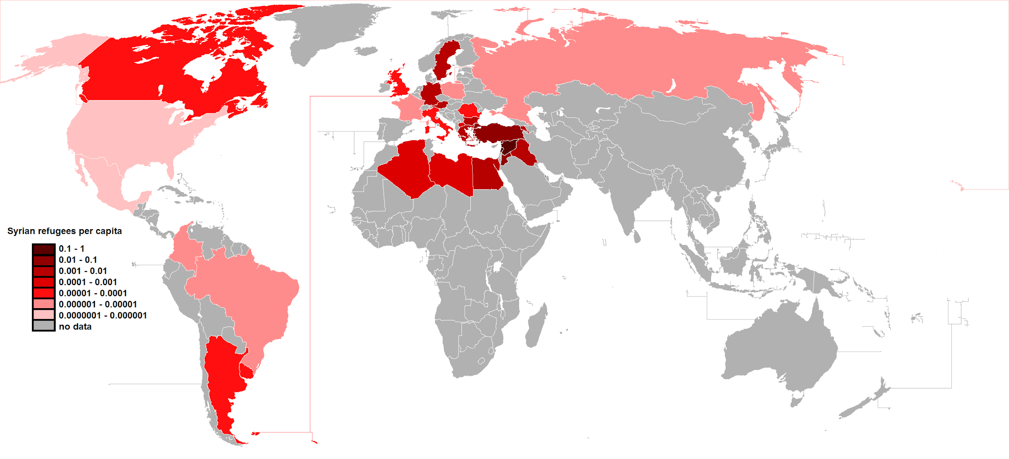
We Cannot Walk Alone Topic Lessons
Afternoon lessons will have a greater focus on the geography aspects of displacement.
Children will have to opportunity to explore maps to identify which countries refugees are from and which countries host the most refugees.
They will also look at the reasons why people flee or choose to leave their countries and explore their journeys.
For the older children, they will be presented with statistics and policies of host countries in order to form educated opinions about what is happening around the world and the reasons behind difficult decisions.

Slide 10
We cannot do this alone; we need your help!
We are also aiming to raise £3000 which will help towards settling a refugee family.

Slide 11
Quiz Night!
As a school community, we value parental involvement; our aim is to create some amazing opportunities where we hope you can help us to raise money for an incredible cause and have fun at the same time!
Join us for our Quiz Night on 30th June which will be hosted by the one and only Mr Banks.
Tickets are £10 each.

Slide 12
Cultural Festival
Towards the end of the term, you’ll be invited to come and view the wonderful art work in which children will be sharing their message about refugees.
The day will be filled with plenty of games, activities and entertainment.
.

Slide 13
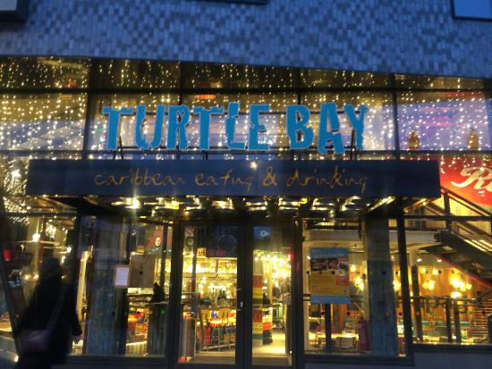
We Cannot Walk Alone Auction
We will be hosting our very own auction sponsored by a variety of businesses.

Slide 14
Thank you!

